Slide 1

Scary Data Stories (& Tips for Warding off Data Vampires)
Ali Ruth | DAE-DLMAB
2024-10-31

Slide 2
Presentation note
This presentation was originally prepared for a data science brown bag at the U.S. Department of State – Bureau of Global Health Security and Diplomacy, Presidential Emergency Program for AIDS relief (PEPFAR).
Commonly used data file format for analyses was Excel
Most common type of data was aggregate clinical data from PEPFAR’s global HIV treatment clinics
All data examples in this presentation are from public-use data sources.

Slide 3


Mysterious Missing Rows
Diabolical Date Formatting
Ghoulish Geolocations
ABOUT DATA

Slide 4
Mysterious Missing Rows
Notes:
Covid: how Excel may have caused loss of 16,000 test results in England | Health policy | The Guardian
Excel: Why using Microsoft's tool caused Covid-19 results to be lost - BBC News Stories | European Spreadsheet Risk Interest Group (eusprig.org)

Slide 5
Mysterious Missing Rows
Public Health England (PHE) usually received Covid testing data from labs in a .csv file format
Notes:
Covid: how Excel may have caused loss of 16,000 test results in England | Health policy | The Guardian
Excel: Why using Microsoft's tool caused Covid-19 results to be lost - BBC News Stories | European Spreadsheet Risk Interest Group (eusprig.org)

Slide 6
Mysterious Missing Rows
Public Health England (PHE) usually received Covid testing data from labs in a .csv file format
One week in October 2020, PHE imported testing data into pre-2007 Excel .xls files
Notes:
Covid: how Excel may have caused loss of 16,000 test results in England | Health policy | The Guardian
Excel: Why using Microsoft's tool caused Covid-19 results to be lost - BBC News Stories | European Spreadsheet Risk Interest Group (eusprig.org)

Slide 7
Mysterious Missing Rows
Public Health England (PHE) usually received Covid testing data from labs in a .csv file format
One week in October 2020, PHE imported testing data into pre-2007 Excel .xls files
Multiple rows per test result
Excel has a row processing limit of:
1,048,576 rows (.XLSX)
65,000 rows (.XLS pre-2007)
Notes:
Covid: how Excel may have caused loss of 16,000 test results in England | Health policy | The Guardian
Excel: Why using Microsoft's tool caused Covid-19 results to be lost - BBC News Stories | European Spreadsheet Risk Interest Group (eusprig.org)

Slide 8

Mysterious Missing Rows
Public Health England (PHE) usually received Covid testing data from labs in a .csv file format
One week in October 2020, PHE imported testing data into pre-2007 Excel .xls files
Multiple rows per test result
Excel has a row processing limit of:
1,048,576 rows (.XLSX)
65,000 rows (.XLS pre-2007)
→15,841 rows of case data disappeared from the document used for contact tracing!
Notes:
Covid: how Excel may have caused loss of 16,000 test results in England | Health policy | The Guardian
Excel: Why using Microsoft's tool caused Covid-19 results to be lost - BBC News Stories | European Spreadsheet Risk Interest Group (eusprig.org)

Slide 9
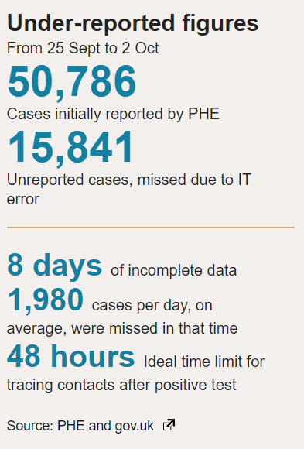
Mysterious Missing Rows
→15,841 rows of case data disappeared from the document used for contact tracing!
Notes:
Covid: how Excel may have caused loss of 16,000 test results in England | Health policy | The Guardian
Excel: Why using Microsoft's tool caused Covid-19 results to be lost - BBC News Stories | European Spreadsheet Risk Interest Group (eusprig.org)

Slide 10
Tips to Address Mysterious Missing Rows
Always know the specs of the dataset
Dimensions (rows x columns)
File size (GB; MB; KB)
Always know the specs of the software
Dimension maximum
File size maximum
Build checks into import/export scripted workflow to check for missing rows or columns

Slide 11
Tips to Address Mysterious Missing Rows
Read and transfer very large datasets using scripted workflows for data wrangling and analysis (RStudio / posit, Python, Stata, SAS, etc.)
If API is available: Also helpful to read in only rows / variables essential for an analysis

Slide 12

Tips to Address Mysterious Missing Rows
For more spooky spreadsheet tales…
European Spreadsheet Risks Interest Group – Spreadsheet Horror Stories Database

Slide 13
Diabolical Date Formatting
Notes:
Gene name errors are widespread in the scientific literature | Genome Biology | Full Text (biomedcentral.com)

Slide 14
Diabolical Date Formatting
Many gene names (SEPT2, MARCH1) have historically been text strings that autoconvert to dates in Excel
Gene name | Gene abbrev | Excel conversion
Septin 2 | SEPT2 | 2-Sept
Membrane-Associated Ring Finger (C3HC4)1, E3 Ubiquitin Protein Ligase | MARCH1 | 1-Mar
Notes:
Gene name errors are widespread in the scientific literature | Genome Biology | Full Text (biomedcentral.com)

Slide 15
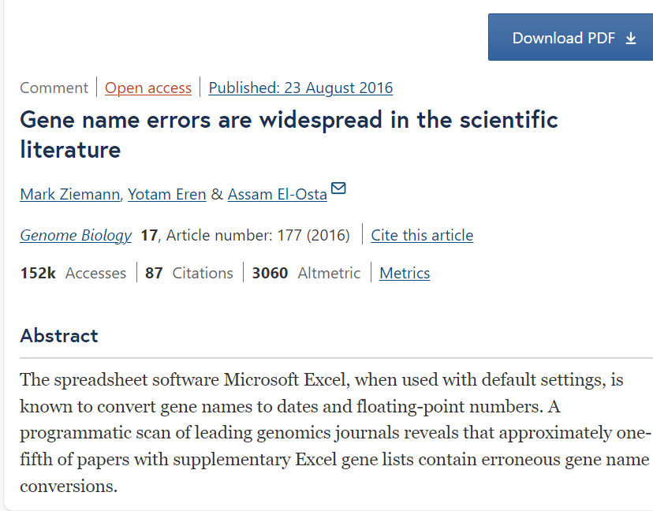
Diabolical Date Formatting
A 2016 study reviewed appendices for a sample of published articles in leading genome journals
Notes:
Gene name errors are widespread in the scientific literature | Genome Biology | Full Text (biomedcentral.com)

Slide 16

Diabolical Date Formatting
A 2016 study reviewed appendices for a sample of published articles in leading genome journals
Approximately one-fifth of studies reviewed contained erroneous gene name conversions
Notes:
Gene name errors are widespread in the scientific literature | Genome Biology | Full Text (biomedcentral.com)

Slide 17
Tips to Address Diabolical Date Formatting
Solutions
Check and confirm variable types when importing data
Best practice: utilize ISO 8601 for date formatting
Largest -> smallest time unit
“2023-10-31”
Facilitates easy sorting and reduces ambiguity
Notes:
Scientists rename human genes to stop Microsoft Excel from misreading them as dates - The Verge

Slide 18

Tips to Address Diabolical Date Formatting
Or: change all the gene names?!...
MARCH1 → MARCHF1
SEPT1 → SEPTIN1
Notes:
Scientists rename human genes to stop Microsoft Excel from misreading them as dates - The Verge

Slide 19
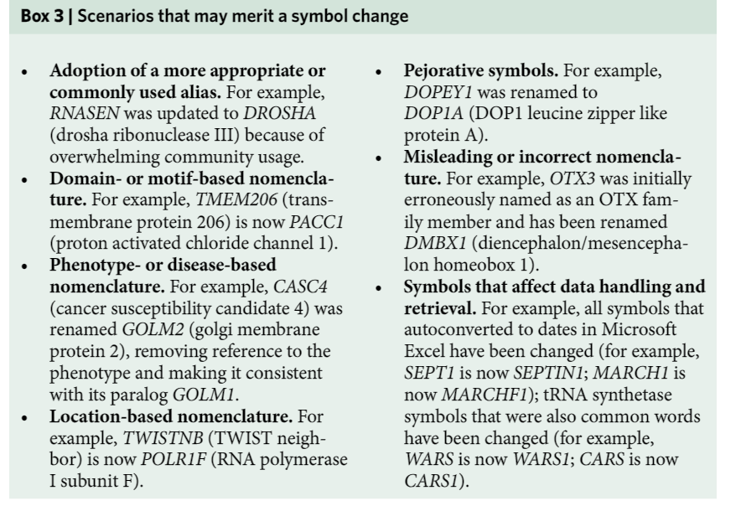
Tips to Address Diabolical Date Formatting
Or: change all the gene names?!...
MARCH1 → MARCHF1
SEPT1 → SEPTIN1
Human Gene Nomenclature Committee 2020 Guidance →
Notes:
Scientists rename human genes to stop Microsoft Excel from misreading them as dates - The Verge

Slide 20
Ghoulish Geolocation Coordinates

Slide 21
Ghoulish Geolocation Coordinates
CMS public use Covid nursing home dataset had a string variable for geographic coordinates that combined latitude and longitude
At first, there was no other info on “GEOLOCATION” field
I split the string variable into what I presumed was latitude and longitude to use for mapping
FACILITY ID | GEOLOCATION
00176 | (-115.121992, 36.107369)
23257 | (-86.311653, 31.001042)
78791 | (-77.05922, 38.734332)
45228 | (-118.036817, 34.061096)

Slide 22
Ghoulish Geolocation Coordinates
FACILITY NAME | GEOLOCATION | latitude | longitude
WESTRIDGE HEALTH CARE CENTER | (84.24571, 39.26015) | 84.24571 | 39.26015

Slide 23
Ghoulish Geolocation Coordinates
FACILITY NAME | GEOLOCATION | latitude | longitude
WESTRIDGE HEALTH CARE CENTER | (84.24571, 39.26015) | 84.24571 | 39.26015
Source: CMS Covid Nursing Home public use dataset
Wrote an R script to map facilities (~15,000 nursing homes in the U.S.) but RStudio kept crashing
Subsetted by states (NV, IN) to try and troubleshoot for smaller lists of facilities

Slide 24
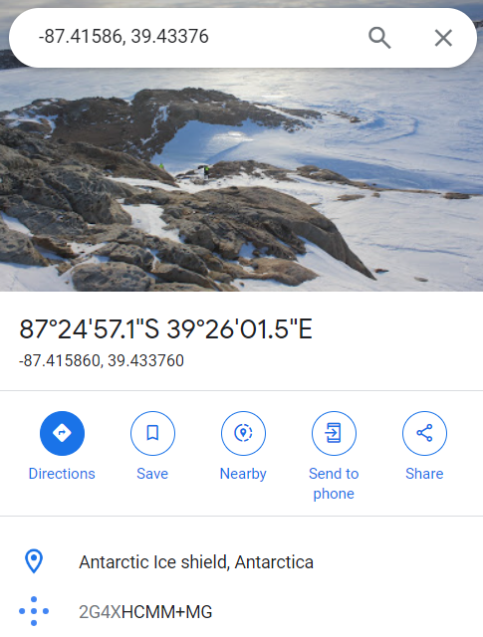
Ghoulish Geolocation Coordinates
A number of the nursing home locations in Indiana had mysteriously flown off to Antarctica

Slide 25

Ghoulish Geolocation Coordinates
A number of the nursing home locations in Indiana had mysteriously flown off to Antarctica
Latitude and longitude were reversed in the original geolocation string!
FACILITY NAME | GEOLOCATION | latitude | longitude
WESTRIDGE HEALTH CARE CENTER | (-87.419773, 39.433756) | -87.419773 | 39.433756

Slide 26
Tips for Addressing Ghoulish Geolocation Coordinates
Data dictionaries are the key to preventing this type of problem
One option that can work well:
High-level, succinct, machine-readable csv variable dictionary paired with
Longer pdf technical documentation
Also great to include contact info on pages with public use federal data so users can provide feedback on documentation!

Slide 27
Tips for Addressing Ghoulish Geolocation Coordinates
var_name | var_type | description | example | range | source | notes
county_name | String | County name | Alameda | NA | Census
county_fips | String | County FIPS code | 11003 | NA | Census
week_ending | Date | Ending date of measured week | 2022-10-11 | 2021-01-01 - 2022-12-31 | JHU Covid database
covid_cases_num | Numeric | Number of covid cases in county, by week | 137 | 0-3429 | JHU Covid database
covid_cases_rate | Numeric | Covid cases per 100k population | 50.2 | 0-441 | JHU Covid database; Census | Population denom derived from Census 5-year ACS survey
Notes:
Getting Started Creating Data Dictionaries: How to Create a Shareable Data Set - Erin M. Buchanan, Sarah E. Crain, Ari L. Cunningham, Hannah R. Johnson, Hannah Stash, Marietta Papadatou-Pastou, Peder M. Isager, Rickard Carlsson, Balazs Aczel, 2021 (sagepub.com)

Slide 28
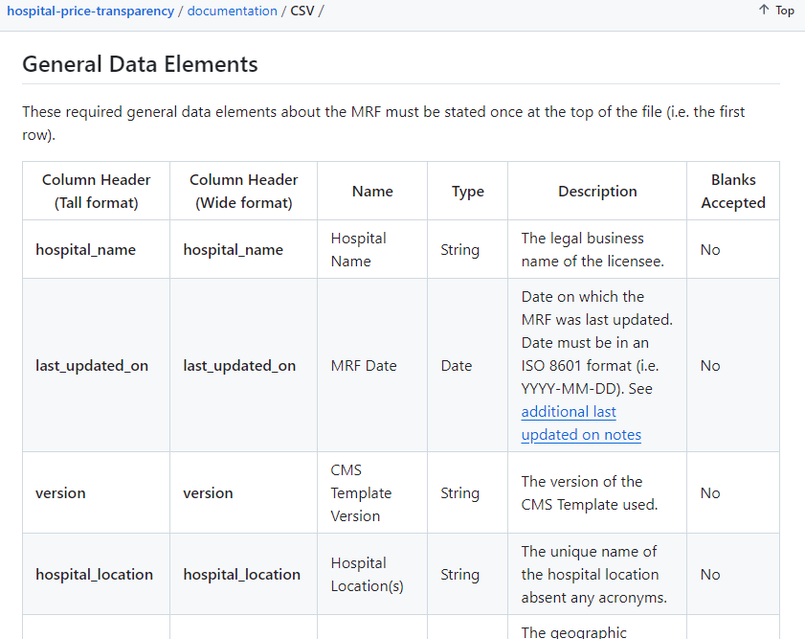
Tips for Addressing Ghoulish Geolocation Coordinates
HHS CMS metadata standards for machine-readable price transparency data: hospital-price-transparency/documentation/CSV at master · CMSgov/hospital-price-transparency

Slide 29
Tips for Addressing Ghoulish Geolocation Coordinates
NCHS metadata standards:
https://intranet.cdc.gov/nchs/data-science/metadata.htm
External resources that go into a nice level of detail about style and formatting advice for data dictionaries and metadata:
Getting Started Creating Data Dictionaries: How to Create a Shareable Data Set
Improving Metadata Infrastructure for Complex Surveys: Insights from the Fragile Families Challenge - PMC (nih.gov)
Notes:
Getting Started Creating Data Dictionaries: How to Create a Shareable Data Set - Erin M. Buchanan, Sarah E. Crain, Ari L. Cunningham, Hannah R. Johnson, Hannah Stash, Marietta Papadatou-Pastou, Peder M. Isager, Rickard Carlsson, Balazs Aczel, 2021 (sagepub.com)

Slide 30
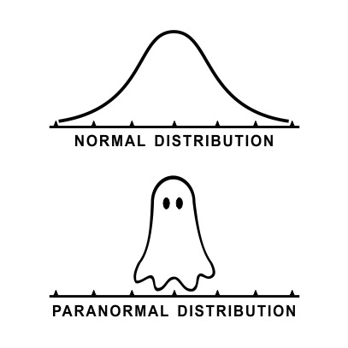
Thank you!

